Slide 1
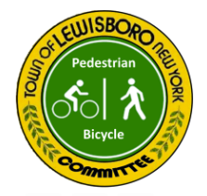
Lewisboro Pedestrian & Bicycle Infrastructure Bond Ballot Measure
April 24, 2023
Town Board Meeting Presentation

Slide 2
What do Town of Lewisboro residents say about their priorities around bicycle and pedestrian issues?

Slide 3
What Lewisboro residents are saying…
“It would be really great to have sidewalks…this is the hub of our hamlet and people are always walking and biking and its very unsafe!”
Vista Resident
“Very concerned with making the crosswalk in front of JJHS safer for the community as well as the intersection in front of Greenway plaza.”
Cross River Resident
“I would love to see 138 become safer for bikers, pedestrians and runners between route 121 and the train station.”
Goldens Bridge Resident

Slide 5
The Lewisboro Pedestrian & Bicycle Committee recommends a
Bond Ballot Measure
to fund projects to improve bicycle and pedestrian safety.

Slide 6
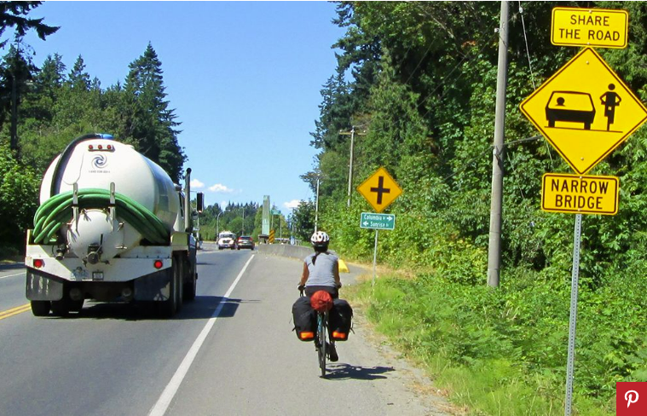
It’s all about SAFETY
Long-recognized deficiencies in Lewisboro
Safe street infrastructure messages “Main Street” encourages safe behavior, and initiates positive feedback loops
The public has indicated strong interest for years
Recent survey by committee found safety is THE concern
Many inputs into Comprehensive Plan are in this category
Supports desires/efforts to enhance hamlet center attractiveness and economic/social vibrancy

Slide 7
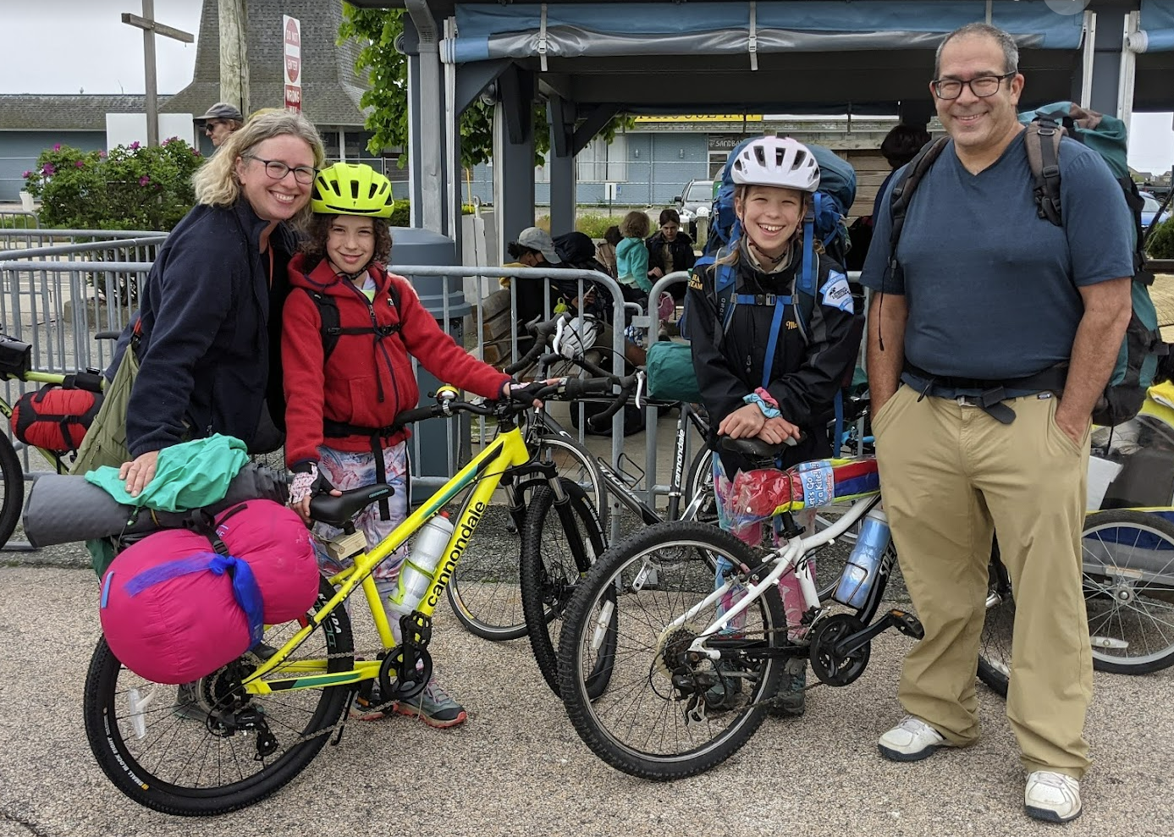
Why Now?
Momentum in community
Ped/Bike Committee Survey results
Comprehensive Plan input
Grant funding attempts in past not successful
Timing works well with Comprehensive Plan

Slide 8
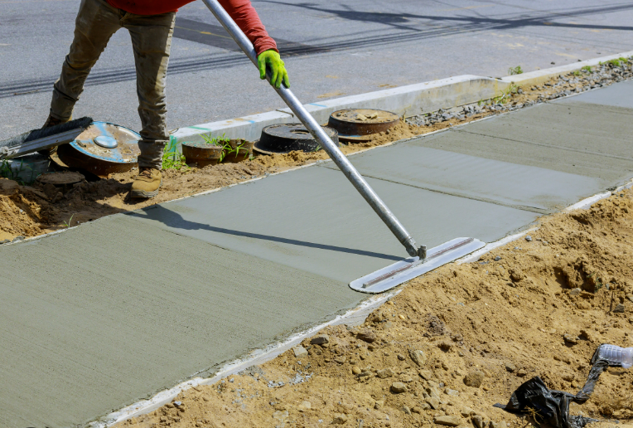
Bonds Help Future Fundraising
With internal funding, projects have a better chance at obtaining external grant funding
Grant funds can go straight to “shovel ready” projects

Slide 9
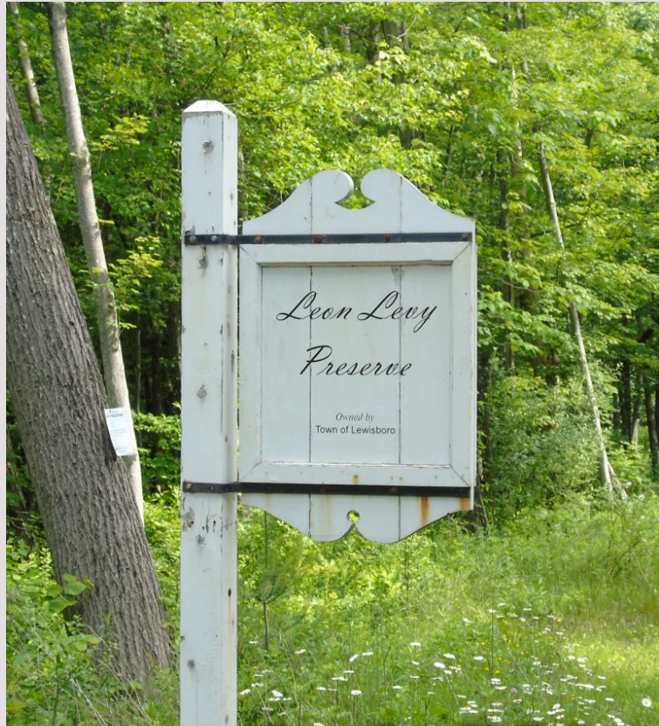
The Leon Levy Preservation Story
A major piece on open space inventory radar, threatened with development.
Preservation proponents recognized the natural resource, organized to gain public attention, and convinced the Board to advance a referendum ($2.0 million).
Public recognized it as a smart investment and it is now beloved.

Slide 10
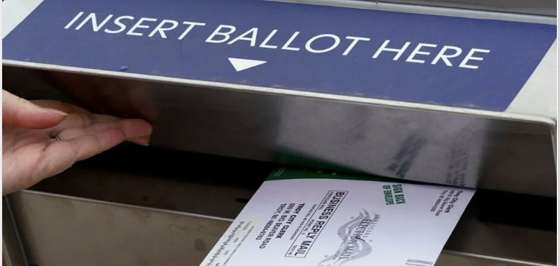
Bond Specifics
Based roughly on scope of prior GB proposal, for each hamlet
Total=$2.1 million
Estimate $66/household/yr (@ 5% for 10 yrs)
Enough to support substantial work

Slide 11
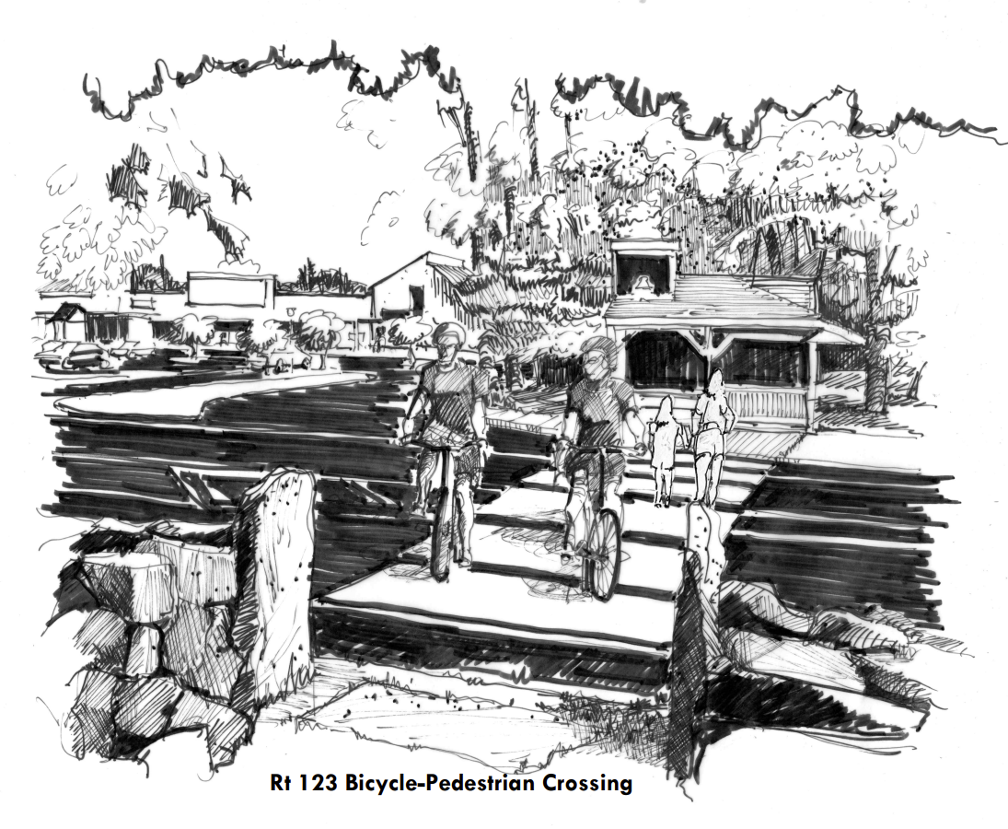
Project Examples
Goldens Bridge – 22/138 intersection area improvements, crossings, light, sidewalks
Cross River - 35/121 intersection, light timings/pushbutton, crosswalks
Vista - Rt 123 as main street, multi-use path to Elmwood Rd

Slide 12
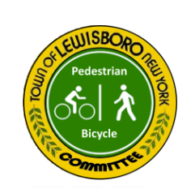
What’s Next?
Resolution by board to put matter on ballot
Submission to State - deadline August 7
Outreach during period up to November to insure residents have information to make choice

Slide 13
Let’s Do This!
Residents are engaged
Bond vote will confirm their support (or not)
Sends signal that the town is listening and acting

Slide 14
Thank you!

